Slide 1
Machine Learning Foundations and Applications
Jiaul Paik

Slide 2
My Plan for the Rest of the Semester
Unsupervised learning
Flat clustering, Graph clustering, Principal component analysis
Deep Neural Network
Feedforward network, CNN, RNN, Attention network
Generative models
Hidden Markov model, Topic models: Latent Dirichlet allocation
Advanced topics
Semi-supervised learning, online learning, adversarial learning, Transfer learning, Positive-unlabelled learning

Slide 3
Today’s Topics
Unsupervised Learning
Kmeans
Kmeans++

Slide 4
Unsupervised Learning

Slide 5
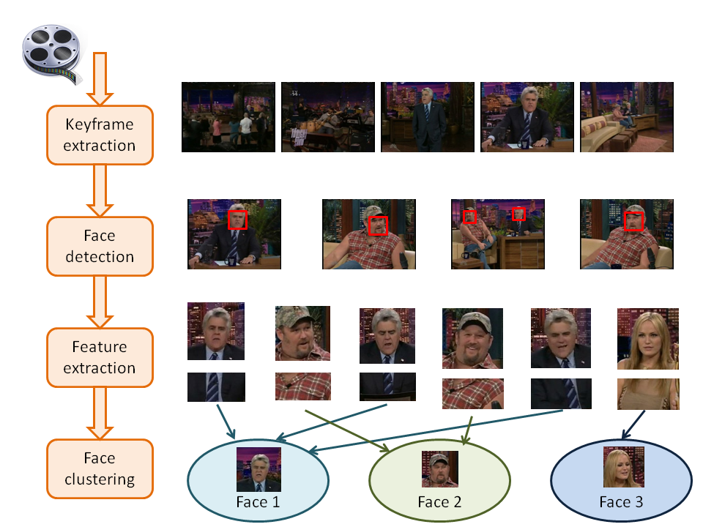
Example: Face Clustering

Slide 6
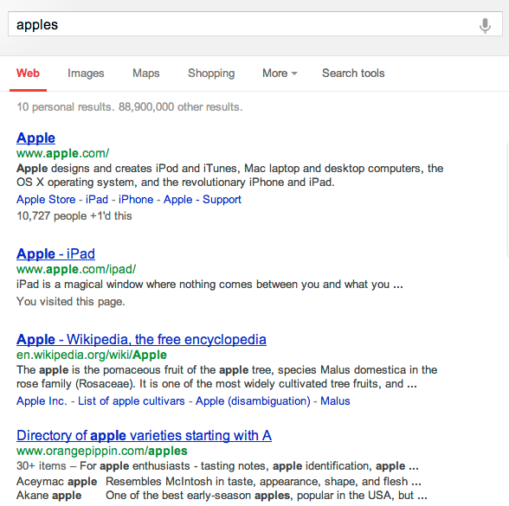
Example: Search result clustering

Slide 7
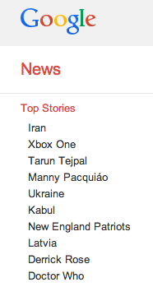
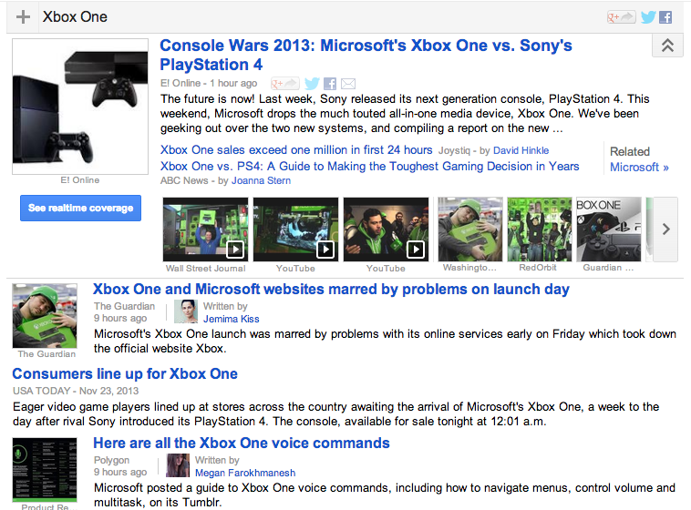
Example: Google News

Slide 8
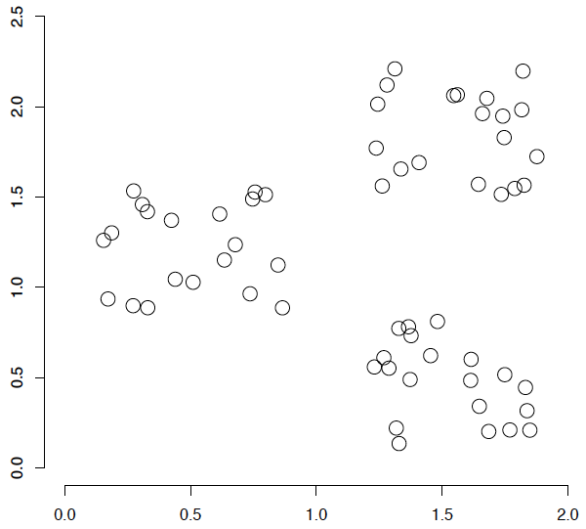
A data set with clear cluster structure
What are some of the issues for clustering?
What clustering algorithms can we use?

Slide 9
Issues for clustering
Representation for clustering
How do we represent an example
features, etc.
Similarity/distance between examples
Flat clustering or hierarchical?
How many clusters you want to create?
Fixed a priori
Data driven

Slide 10
Major Types of Clustering Algorithms
Flat algorithms
Usually start with a random partitioning
Refine it iteratively
Example: K-means clustering
Produces disjoint set of groups
Hierarchical algorithms
Bottom-up, agglomerative
Top-down, divisive

Slide 11
Hard vs. soft clustering
Hard clustering:
Each example belongs to exactly one cluster
Soft clustering:
An example can belong to more than one cluster (probabilistic)
A pair of sneakers may belong to two groups
sports apparel and shoes

Slide 12
Flat Clustering: K-mean Clustering algorithm

Slide 13
K-means
K-means is simple, efficient and widely used
Main steps of k-means:
STEP 1: Start with k initial cluster centers (that is why k-mean ☺)
STEP 2: Assign/cluster each member to the closest center
go back here
Iterative steps
STEP 3: Recalculate centers as the mean of the points in a cluster
When to stop?
Some possibilities
1. after fixed # iteration
2. when centers do not change

Slide 14
K-means: an example

Slide 15
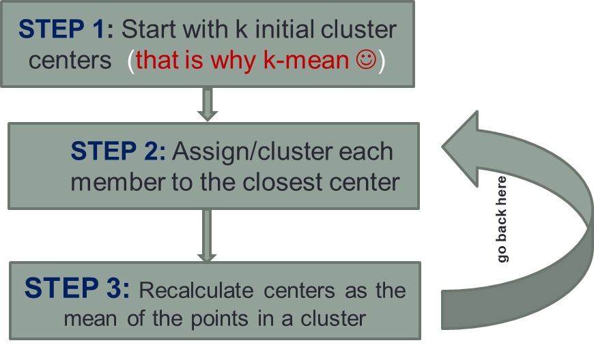
K-means: Initialize centers randomly

Slide 16
K-means: assign points to nearest center

Slide 17
K-means: readjust centers

Slide 18
K-means: assign points to nearest center

Slide 19
K-means: readjust centers

Slide 20
K-means: assign points to nearest center

Slide 21
K-means: readjust centers

Slide 22
K-means: assign points to nearest center
No changes: Done

Slide 23
K-means
Iterate:
Assign/cluster each example to closest center
Recalculate centers as the mean of the points in a cluster
How do we do this?

Slide 24
K-means
Iterate:
Assign/cluster each example to closest center
Iterate over each point:
- get distance to each cluster center
- assign to closest center (hard cluster)
Recalculate centers as the mean of the points in a cluster

Slide 25
K-means
Iterate:
Assign/cluster each example to closest center
Iterate over each point:
- get distance to each cluster center
- assign to closest center (hard cluster)
Recalculate centers as the mean of the points in a cluster
What distance measure should we use?

Slide 26
Distance measure
Euclidean:
x and y are n-dimensional vectors:
x = ($x_{1},x_{2}, ….., x_{n}$)
y = ($y_{1}, y_{2}, ….., y_{n}$)

Slide 27
K-means
Iterate:
Assign/cluster each example to closest center
Recalculate centers as the mean of the points in a cluster
Where are the cluster centers?

Slide 28
K-means
Iterate:
Assign/cluster each example to closest center
Recalculate centers as the mean of the points in a cluster
How do we calculate these?

Slide 29
K-means
Iterate:
Assign/cluster each example to closest center
Recalculate centers as the mean of the points in a cluster
Mean of the points in the cluster:

Slide 30
K-means loss function
K-means tries to minimize what is called the “k-means” loss function:
The sum of the squared distances from each point to the associated cluster center.

Slide 31
Running time of Kmeans
In every iteration
Assign data points to closest cluster center
O(kn) time (k = # clusters, n = # data points)
Change the cluster center to the average of its assigned points
O(n)

Slide 32
K-means: Big Issues
Value of k (# cluster)
How to stop?
A fixed number of iterations
partitions unchanged
Cluster centers do not change
Initial (seed) cluster centers

Slide 33
Kmeans: Value of k

Slide 34
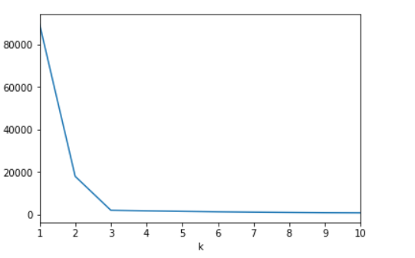
Elbow method
Run kmeans with different k
Plot k-means loss vs. k
Choose k such that the curve show an elbow shape
Kmeans loss
Good value of k

Slide 35
Silhouette Measure
Key Idea for good clustering
Small within cluster variance
Large between cluster variance

Slide 36



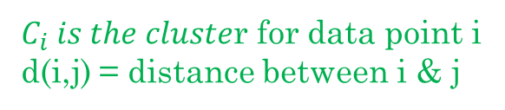
Silhouette Measure
$C_{i} is the cluste$r for data point i
d(i,j) = distance between i & j
Within cluster measure
Between cluster measure
Silhouette measure
s(i) = 0, if $\left|C_{i}\right|=1$

Slide 37
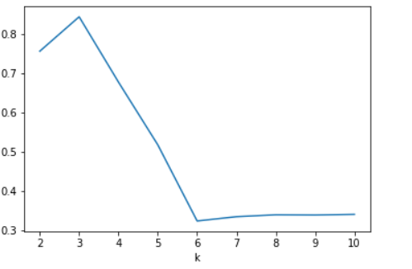
Silhouette Plot
Property of the Silhouette measure:
High score is better
Desirable value of k
$$\frac{1}{n}\sum_{i=1}^{n}{S(i)}$$
Average Silhouette score

Slide 38
Initial (seed) cluster centers

Slide 39
K-means: Initialize centers randomly
What would happen here?

Slide 40
K-means: Initialize centers randomly
Bad clustering

Slide 41
Choice of Initial Centroids
Results can vary drastically based on random seed selection
Slow convergence
converges to sub-optimal clustering
Common heuristics
Random centers in the space
Randomly pick from feature vectors
Points least similar to any existing center (furthest centers heuristic)
Try out multiple starting points
Initialize with the results of another clustering method

Slide 42
Furthest centers heuristic
μ₁ = pick random point (the first center)
$for i=2 to k$ (# cluster)
μ_{i} = point that is furthest from any previous centers

Slide 43
K-means: Initialize furthest from centers
Say, k = 3
Pick a random point for the first center
Which point will be chosen next?
Next point?

Slide 44
K-means: Initialize furthest from centers
Furthest point from center
Any issues/concerns with this approach?

Slide 45
Furthest points concerns
If k = 4, which points will get chosen?
Doesn’t deal well with outliers

Slide 46

A Better Approach
K-means++
Centers are initialized using a probabilistic approach
Other steps are exactly the same as the standard k-means algorithm
Cluster centers initialization:
Choose one center $c_{1}$ randomly from the data (X)
For each $x∈X$, compute D(x)
(D(x) is the distance of x from the closest center we have already chosen)
Select a data $x$ from X as a new center with probability $\frac{D{\left(x\right)}^{2}}{\sum_{x∈X}{D{\left(x\right)}^{2}}}$
Repeat step 2 and 3 until k centers are chosen

Slide 47
K-means++
Cluster centers initialization:
Choose the first center randomly from the data, X
For each $x∈X$, compute D(x) (D(x) is the distance of x from the closest center we have already chosen)
Select a data $x$ from X as a new center with probability $\frac{D{\left(x\right)}^{2}}{\sum_{x∈X}{D{\left(x\right)}^{2}}}$
Repeat step 2 and 3 until k centers are chosen
Illustration: say we want to create 3 clusters
most likely second center
Quiz:
Given the two centers, what will be the D(x)?
length of black line or read line?
first center
x
most likely third center

